Slide 1
Interfacing Mathematics and Medicine: Predicting Cancer Patient Response to Checkpoint Inhibitor Immunotherapy
Joseph D. Butner, PhD
October 14, 2021

Slide 2
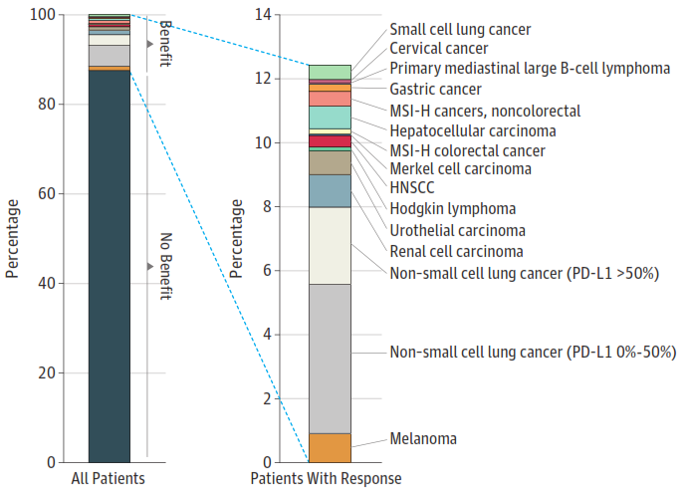
Immunotherapy
Using the body’s own immune system to fight its cancer
Reported response to checkpoint inhibitors (2018)
Activates immune response against the tumor
Can succeed when traditional therapies fail
To date, only a minority of patients respond
Need for improved prognostics
Haslam A, Prasad V. Estimation of the Percentage of US Patients With Cancer Who Are Eligible for and Respond to Checkpoint Inhibitor Immunotherapy Drugs. JAMA Netw Open. Published online May 03, 20192(5):e192535. doi:10.1001/jamanetworkopen.2019.2535

Slide 3
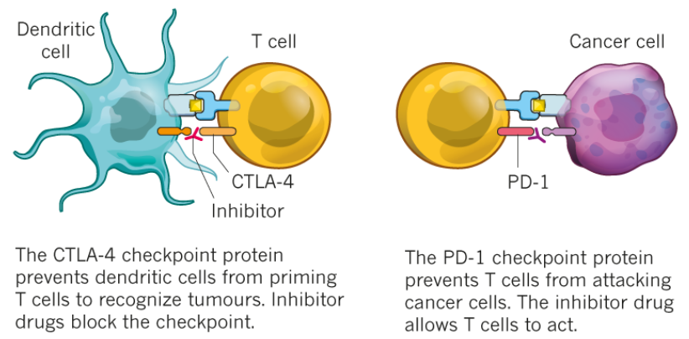
Checkpoint Inhibitors
Mechanisms of action
Cancer cells disable immune T cells by activating their immune checkpoints
Checkpoint inhibitors block this pathway, allowing T cells to remain active
One active T cell can kill 1,000’s of cancer cells
https://www.nature.com/articles/d41586-018-06751-0

Slide 4
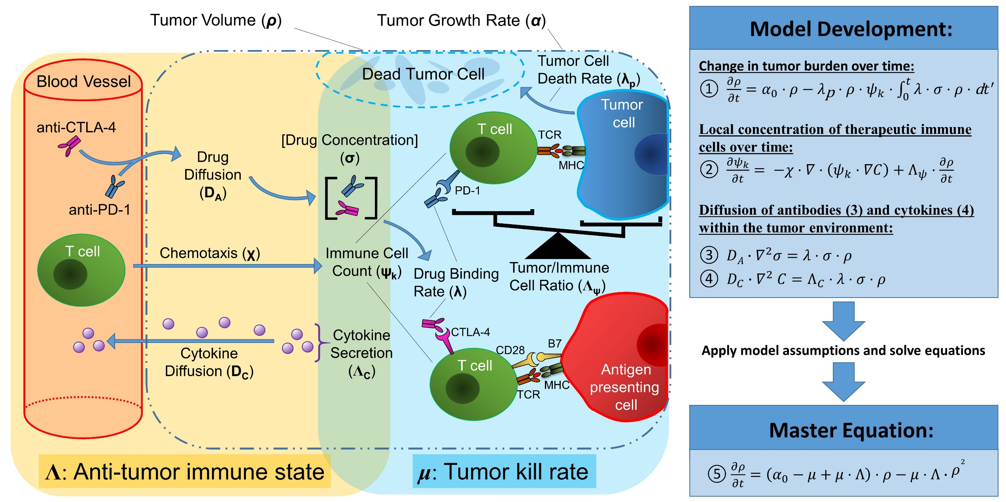
Biological Considerations
What should be included in the model?

Slide 5
Overcoming Clinical Limitations
What can we actually measure?
To be used clinically, we must make some biologically reasonable assumptions
Immune cells and antibodies are relatively diffuse within the tumor
Immune cells are in close proximity to tumor cells
Antibody binding and associated cancer kill rates are faster than measureable tumor volume change
Based on what can be measured using clinically available technology
Allows us to solve for the “master equation”
Symbol | Definition
ρ | Tumor volume
Λ | Anti-tumor immune state
μ | Tumor kill rate
α | Tumor growth rate
$$\frac{∂ρ}{∂t}=ρ\left(α−μ+μ∧\right)+ρ^{2}\left(−∧μ\right)$$

Slide 6
Model “Super-parameters”
Represent several key underlying biological processes
Cancer cell kill rate (μ)
$$μ=λ_{\text{kill}}⋅ψ_{0}⋅σ_{\text{binding}}$$
Anti-tumor immune state (Λ):
$$Λ=\frac{{ρ_{0}}/{ψ_{0}}}{f}$$
These are mathematical markers: parameters of the mathematical model that correlates with one or more biologically or clinically relevant parameters, and are predictive of treatment outcome
$λ_{\text{kill}}$: a pharmaco-dynamic coefficient representing the specific kill rate per immune cell and per molecule of drug (1/day/cell/molecule)
$ψ_{0}$: total immune cell count (baseline)
$σ_{\text{binding}}$: total amount of bound immunotherapy drug (intratumoral)
$ρ_{0}$: total tumor cell count (baseline)
f: immune cell fitness; total number of cancer cells an immune cell can kill

Slide 7
Other Important Equations
Allow calculation of model outputs of interest
Long-term tumor burden:
$$ρ_{∞}= \frac{α_{0}−μ}{μ∙∧}+1$$
Short-term growth rate (at 1st restaging):
$$α_{1} =α_{0}−μ_{1}$$
Time-dependent solution:
$$ρ\left(t\right)=\frac{ρ_{∞}}{1−\left(1−ρ_{∞}\right)e^{−A∙t}}$$
Symbol | Definition
ρ | Tumor volume
Λ | Anti-tumor immune state
μ | Tumor kill rate
α | Tumor growth rate
$$A=α_{0}−μ+μ⋅∧$$

Slide 8
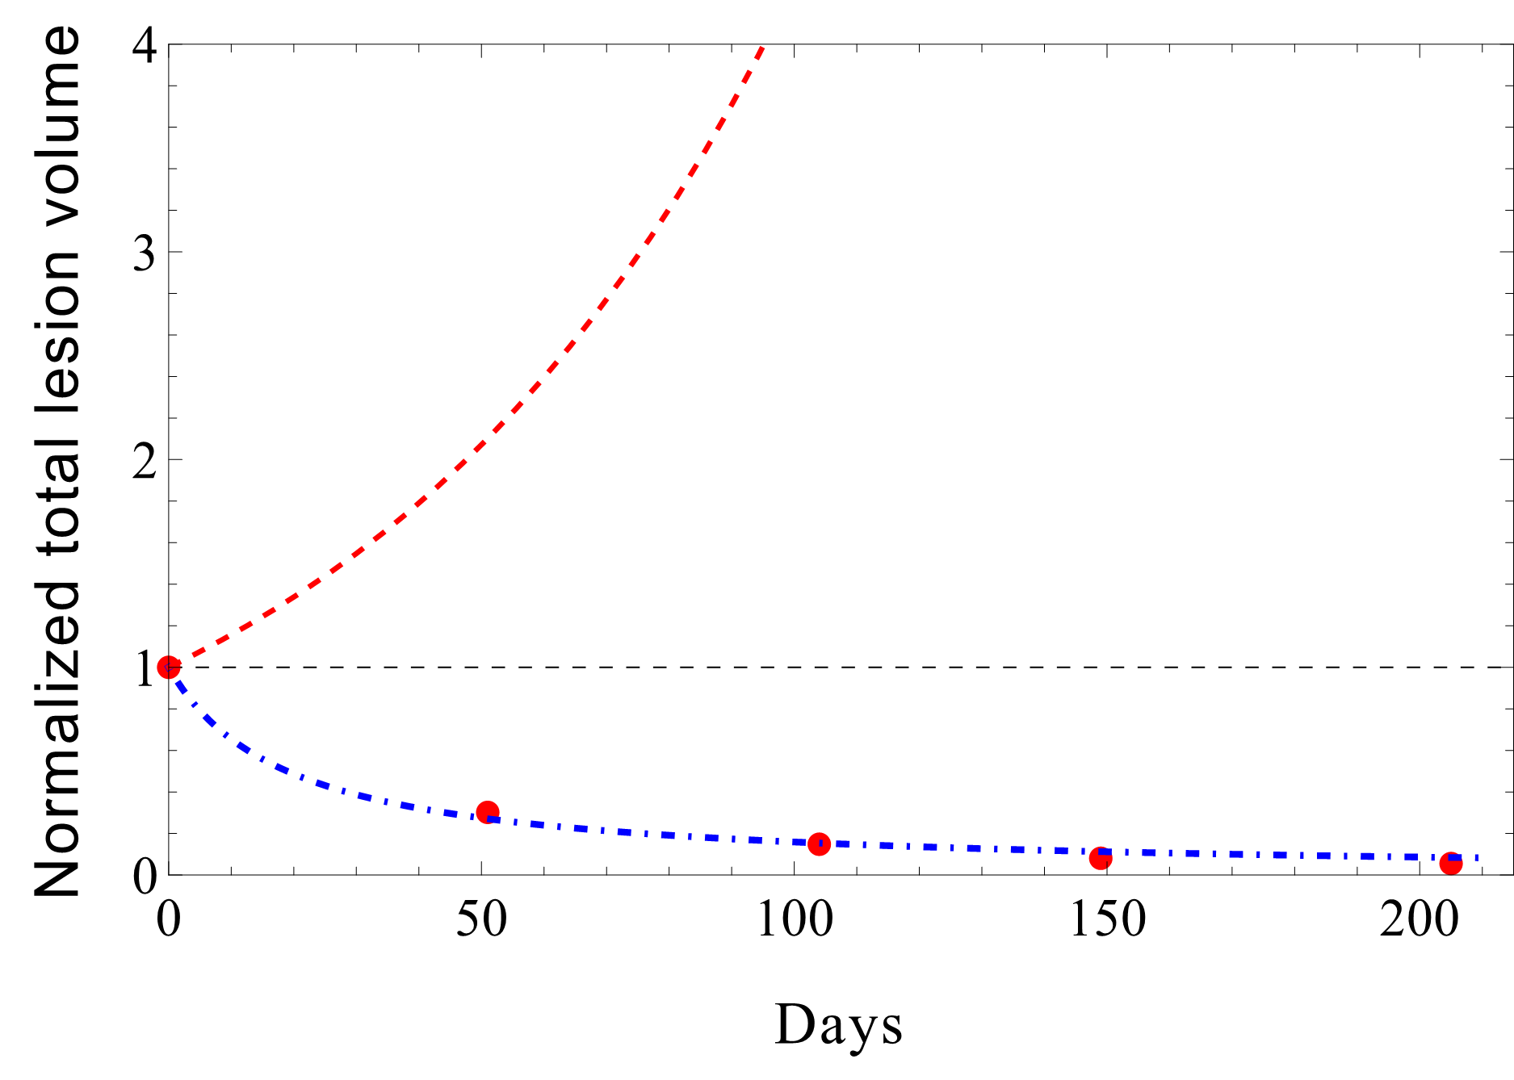
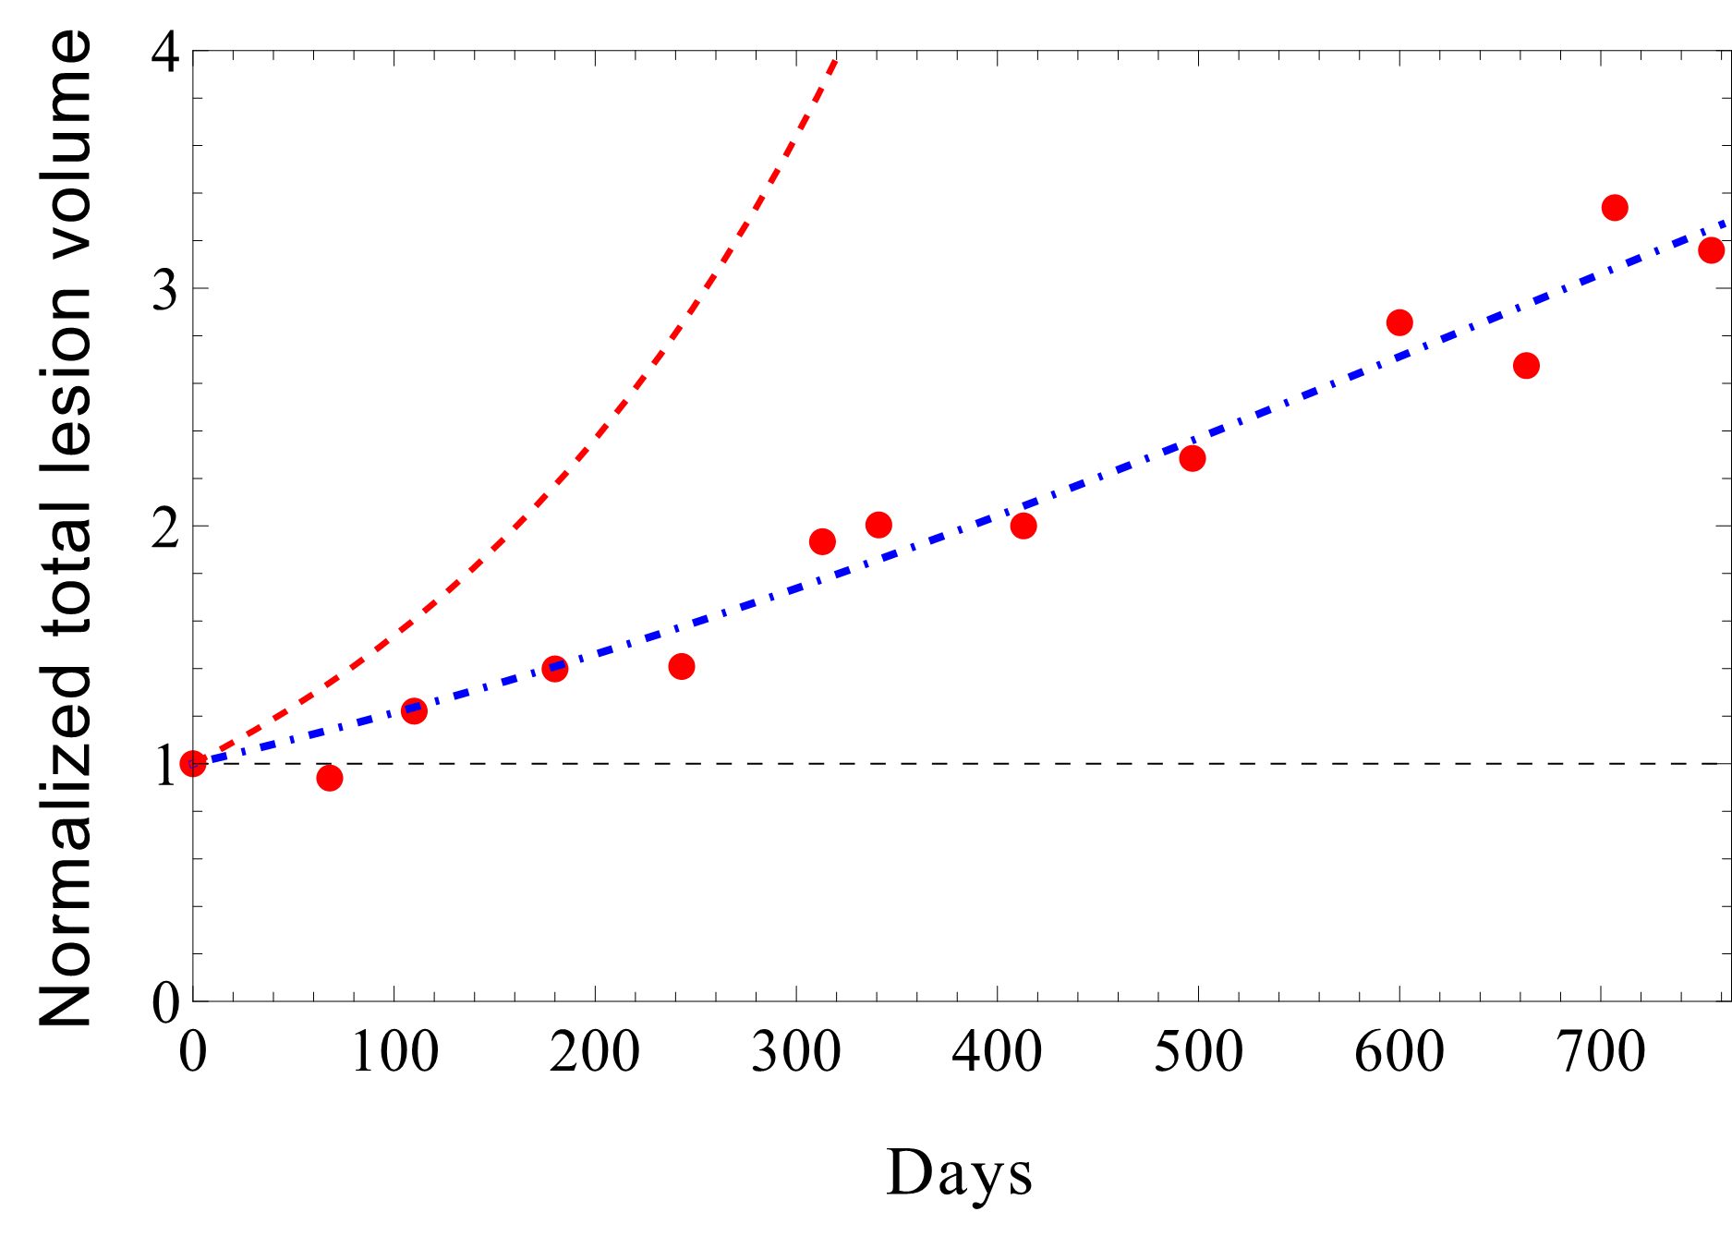
Example Patients
Responders and non-responders
Symbol | Definition
ρ | Tumor volume
Λ | Anti-tumor immune state
μ | Tumor kill rate
α | Tumor growth rate
$$\frac{∂ρ}{∂t}=ρ\left(α_{0}−μ+μ∧\right)+ρ^{2}\left(−∧μ\right)$$
“Responder”
(cancer shrinks)
“Non-responder”
(cancer grows)

Slide 9
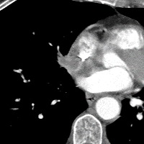
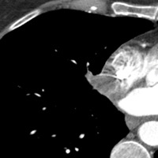
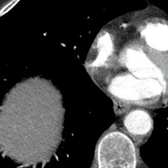
Clinical Implementation
Adding clinical value using only standard-of-care CT measurements
First
Restaging
Expiration or
Last follow-up
Diagnosis
Patient Timeline
Checkpoint Inhibitors
CT imaging
Measured parameter
ρ₋₁
ρ₀
ρ₁
ρ∞
before drug is delivered
start of checkpoint inhibitor therapy
first restaging
last restaging or long-term

Slide 10
Clinical Implementation
Adding clinical value using only standard-of-care CT measurements
First
Restaging
Expiration or
Last follow-up
Diagnosis
Patient Timeline
Checkpoint Inhibitors
CT imaging
Measured parameter
ρ₋₁
ρ₀
ρ₁
ρ∞
Retrospective tumor growth:
$$α_{∞}=α_{0}−μ$$
before drug is delivered
Baseline tumor growth:
$$α_{0}=\frac{ln⁡\left({ρ_{0}}/{ρ_{−1}}\right)}{t_{0}−t_{−1}}$$
start of checkpoint inhibitor therapy
Calculated parameters
Prospective tumor growth at 1st restaging:
first restaging
$$α_{1}=\frac{ln⁡\left({ρ_{1}}/{ρ_{0}}\right)}{t_{1}−t_{0}}$$

Slide 11
Model Validation
Applying the model to patient data
Institutional single-study patient cohort
Anti-CTLA4 checkpoint inhibitor therapy (ipilimumab)
93 patients
NCT02239900 (MD Anderson Cancer Center)
Institutional mixed cohort
various checkpoint inhibitors and cancer types
“basket of basket” study
28 patients
Literature-derived cohort
124 patients
Cancer type | Drug | Number of cases | Source
RCC | Nivolumab | 23 | [1]
NSCLC | Nivolumab | 41 | [2]
Melanoma | Nivolumab | 17 | [3]
UCC | Atezolizumab | 43 | [4]
[1] Motzer RJ, et al. Nivolumab for Metastatic Renal Cell Carcinoma: Results of a Randomized Phase II Trial. J Clin Oncol 33, 1430-1437 (2015).
[2] Borghaei H, et al. Nivolumab versus Docetaxel in Advanced Nonsquamous Non–Small-Cell Lung Cancer. New England Journal of Medicine 373, 1627-1639 (2015).
[3] Topalian SL, et al. Safety, activity, and immune correlates of anti-PD-1 antibody in cancer. N Engl J Med 366, 2443-2454 (2012).
[4] Powles T, et al. MPDL3280A (anti-PD-L1) treatment leads to clinical activity in metastatic bladder cancer. Nature 515, 558-562 (2014).

Slide 12
Institutional Mixed Cohort
Specific cancer diagnosis for each patient
Patient # | Cancer type
1 | Retroperitoneal liposarcoma
2 | Adrenocortical carcinoma
3 | Renal cell carcinoma
4 | NSCLC
5 | Renal cell carcinoma
6 | Gastric neuroendocrine tumor
7 | Renal cell carcinoma
8 | Squamous cell carcinoma of the urethra
9 | Renal cell carcinoma
10 | Lobular carcinoma of the breast
11 | Cholangiocarcinoma
12 | Liposarcoma
13 | Metastatic liposarcoma
14 | Metastatic adenoid cystic ca of submandibular gland
Patient # | Cancer type
15 | Adrenocortical carcinoma
16 | Ovarian cancer
17 | Oropharynx cancer
18 | Melanoma
19 | Squamous cell carcinoma of the cervix
20 | Prostate adenocarcinoma
21 | Pancreatic ductal adenocarcinoma
22 | Leiomyosarcoma
23 | Lung adenocarcinoma
24 | Squamous cell carcinoma of the cervix
25 | Squamous cell carcinoma of the cervix
26 | Squamous cell carcinoma of the cervix
27 | Squamous cell carcinoma of the cervix
28 | Endometrial adenocarcinoma
Notes:
No more than 5 seconds on this slide

Slide 13
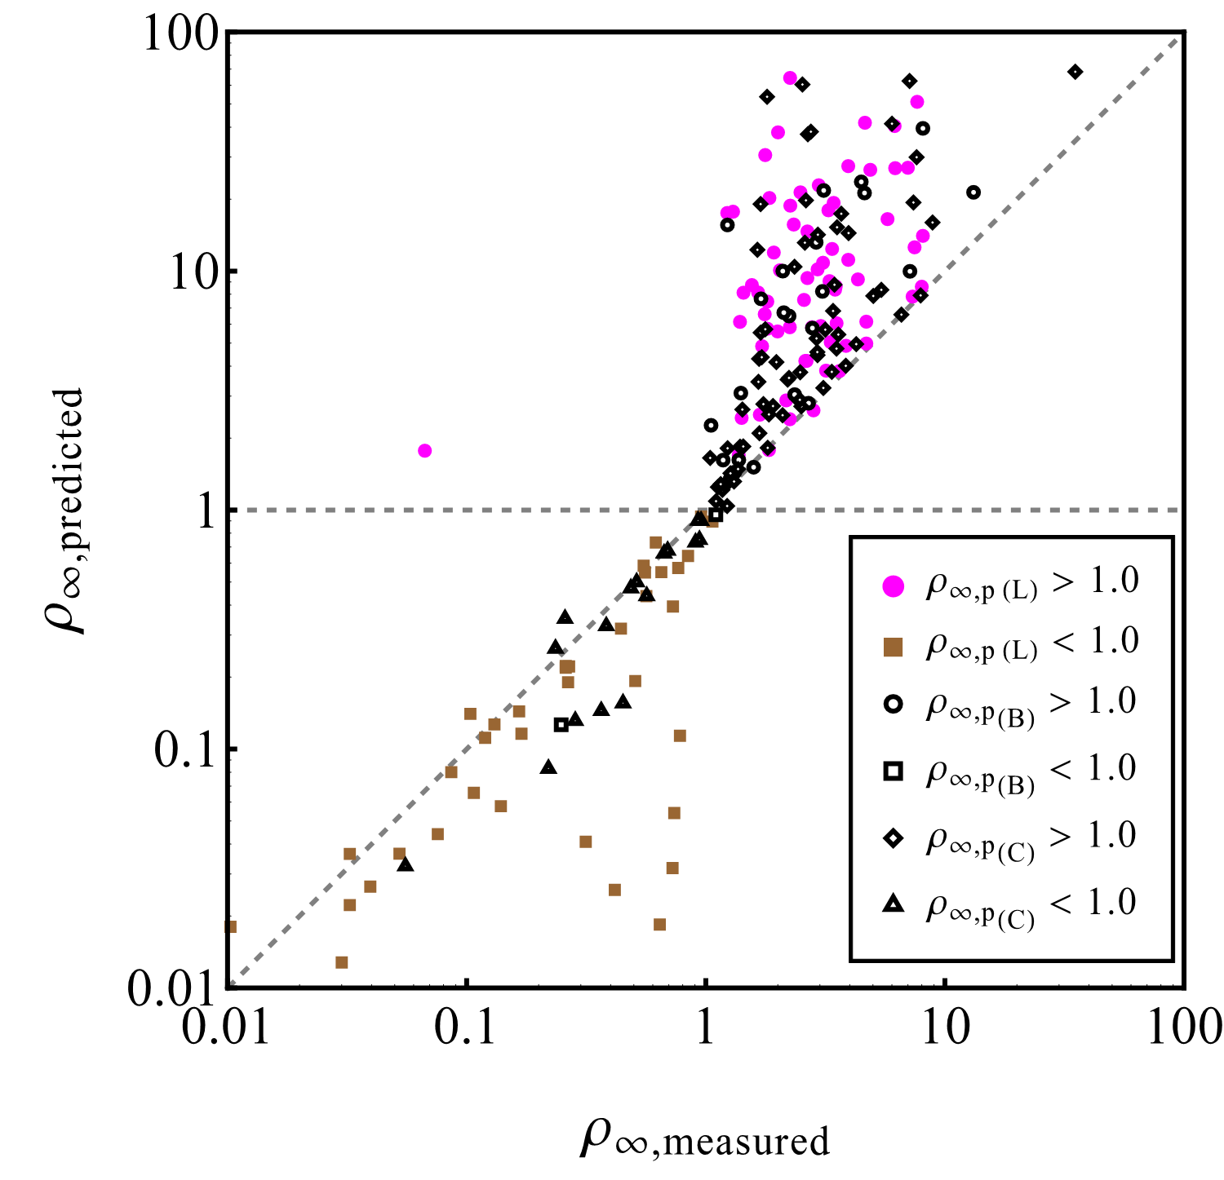
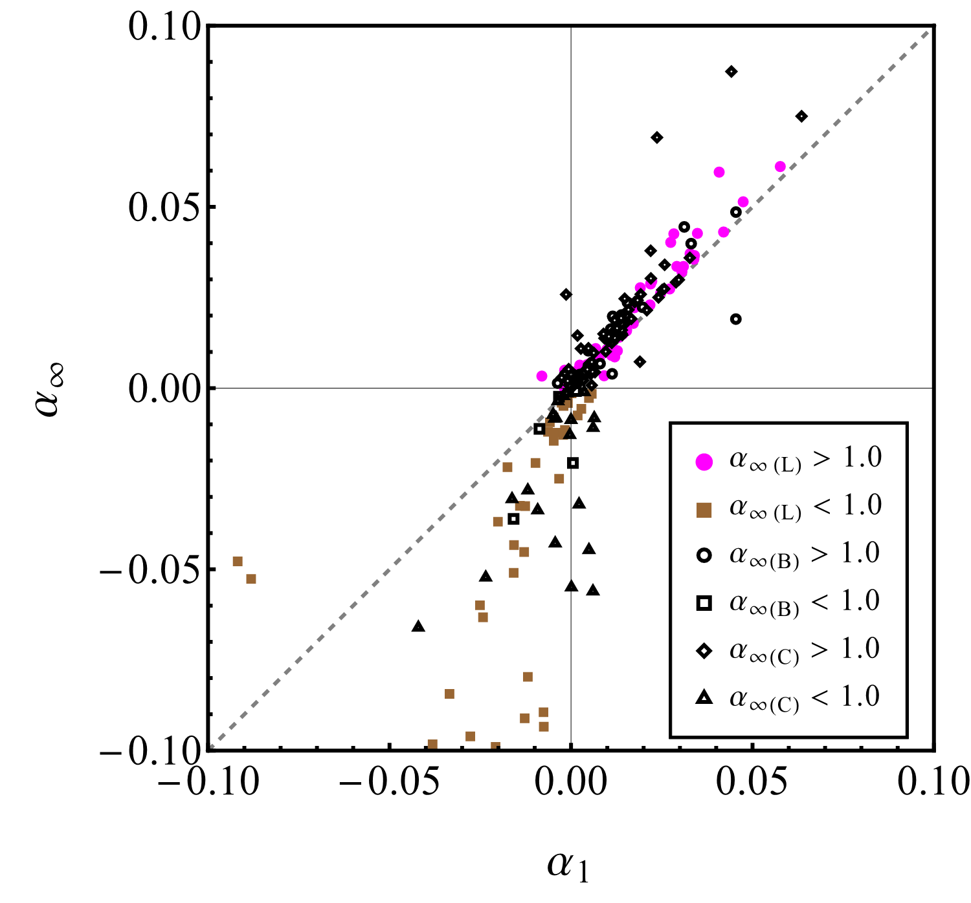
Model validation
Model predicts final tumor burden and long-term growth rates
R = 0.600
P < 0.001
R = 0.697
P < 0.001
(L)iterature-derived cohort (n = 124)
(B)asket of basket studies cohort (n = 28)
(C)linical trial cohort (n = 93)
α₁: tumor growth rate calculated at first restaging
α∞: model predicted long-term tumor growth rate

Slide 14
Immunohistochemistry
Do model parameters capture the biology they represent?
Intratumoral immune cell count:
$$ψ_{k}=Λ\frac{ψ_{0}}{ρ_{0}}\left(ρ−ρ_{0}\right)+ψ_{0}$$
$ρ_{0}$, $ψ_{0}$: tumor and immune counts at baseline
$ρ$, $ψ_{k}$: tumor and immune cell counts after start of treatment
Final tumor burden:
$$ρ^{∞}= \frac{α_{0}−μ}{μ∙∧}+1$$
$$μ=λ_{\text{kill}}⋅ψ_{0}⋅σ_{\text{binding}}$$
1% PD-L1 Staining Cutoff
5% PD-L1 Staining Cutoff
Model
Literature
Intratumoral CD8 count (cells/mm²)
Response rate to immunotherapy (%)
PR/CR
Stable/progressive
<1%
≥1%
<5%
≥5%
Notes:
We estiamge sigma_binding by PD-L1 staining: more receptors, more binding

Slide 15
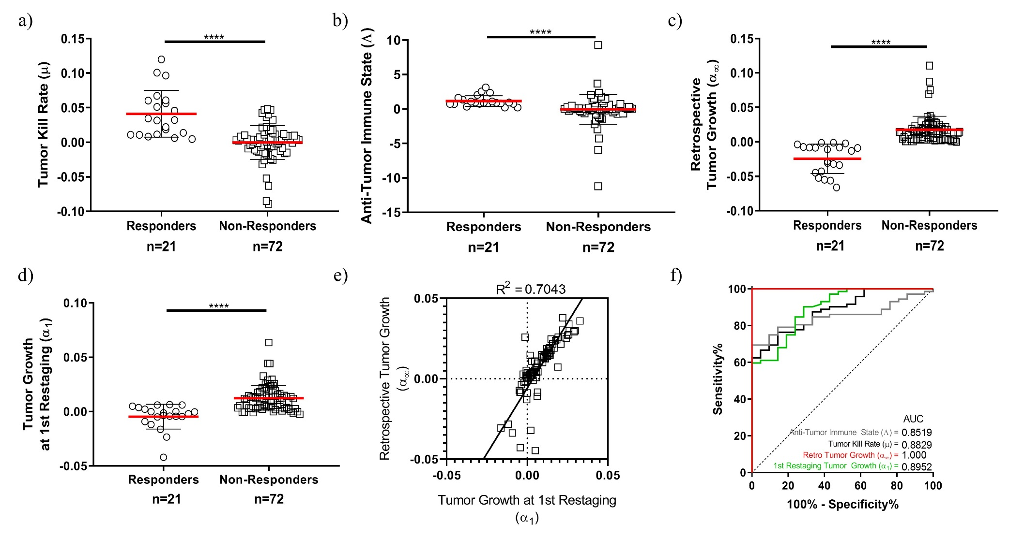
Institutional Single-study Cohort
Model parameters identify patient response
Anti-CTLA4 (ipilimumab)
n = 93 patients

Slide 16
Institutional Single-study Cohort
Model parameters identify patient response
Anti-CTLA4 (ipilimumab)
n = 93 patients
First restaging:
Median 53 days (ranged 17–91 days)

Slide 17
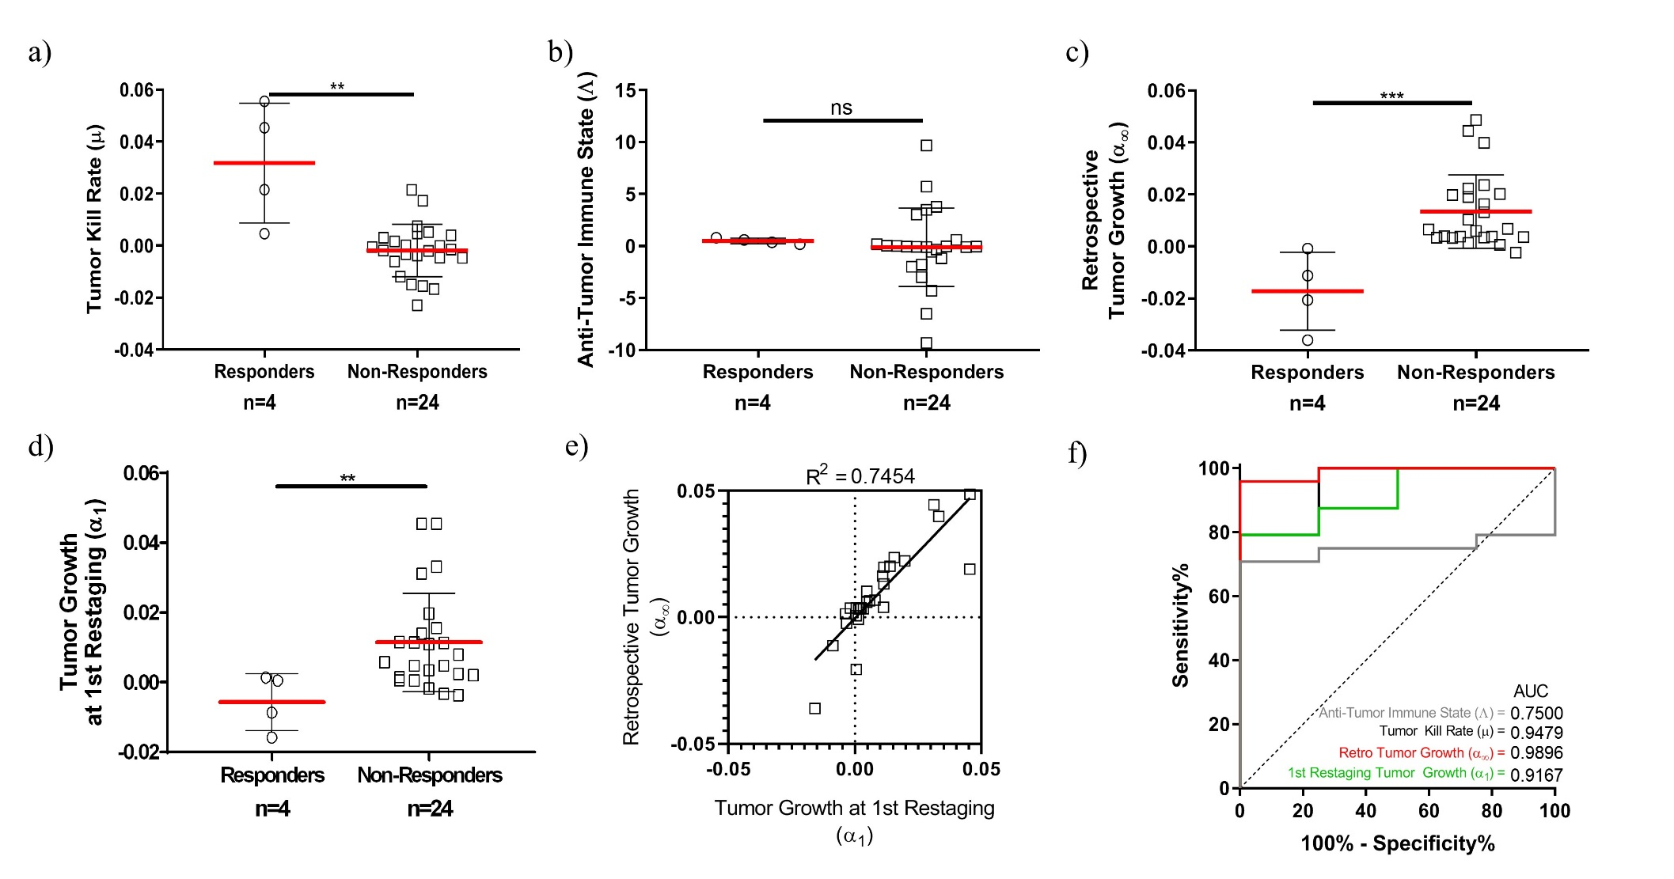
Institutional Mixed Cohort
Model performs well across disease and drug types

Slide 18
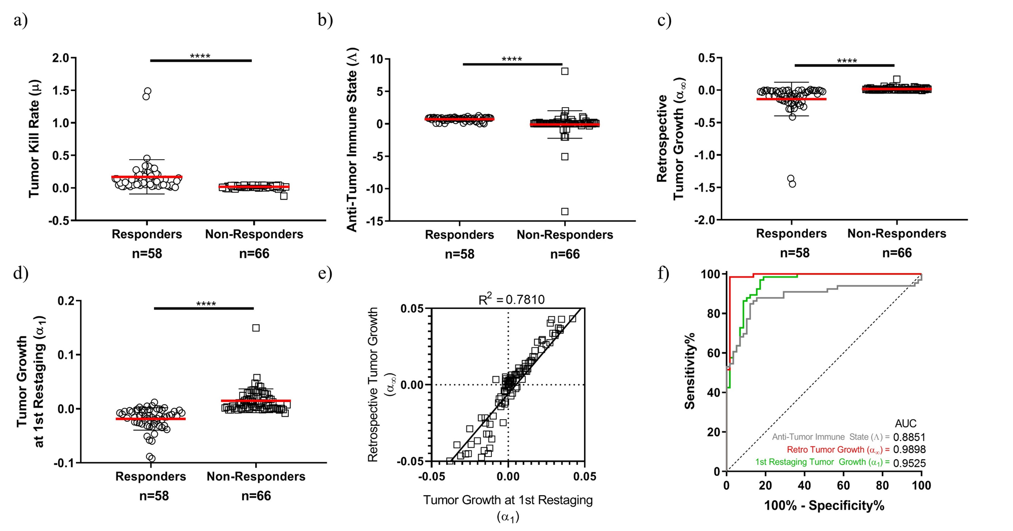
Literature-derived Cohort
Testing the model under minimum-information conditions
Cancer type | Drug* | Number of cases
RCC | Nivo | 23
NSCLC | Nivo | 41
Melanoma | Nivo | 17
UCC | Atezo | 43
*Nivo = nivolumab
*Atezo = Atezolizumab

Slide 19
Predicting Patient Survival
Growth rate at first restaging (α₁) may be used prognostically
Institutional Single-study Cohort (n = 93)
Institutional Mixed Cohort (n = 28)
Notes:
Survival data is unknown in the literature-derived cohort

Slide 20
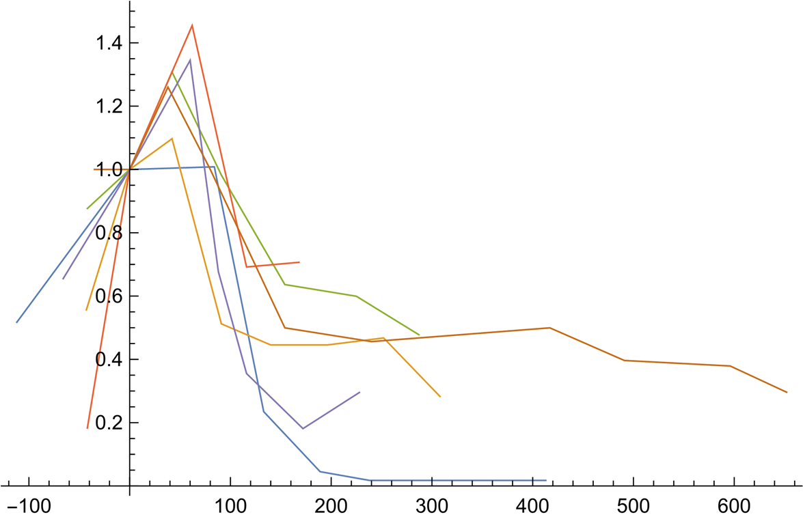
Pseudoprogression
An especially challenging clinical phenomenon
Tumor appears to continue growing, followed by delayed response
Clinically, it is difficult to differentiate nonresponsive disease from pseudoprogression
Pseudoprogression in the institutional single-study cohort (n = 6)
Normalized tumor burden (ρ₀)
Time (days)

Slide 21
Pseudoprogression
Model gives mechanistic insights
Characterized by a delayed “ramping-up” of tumor kill rate

Slide 22
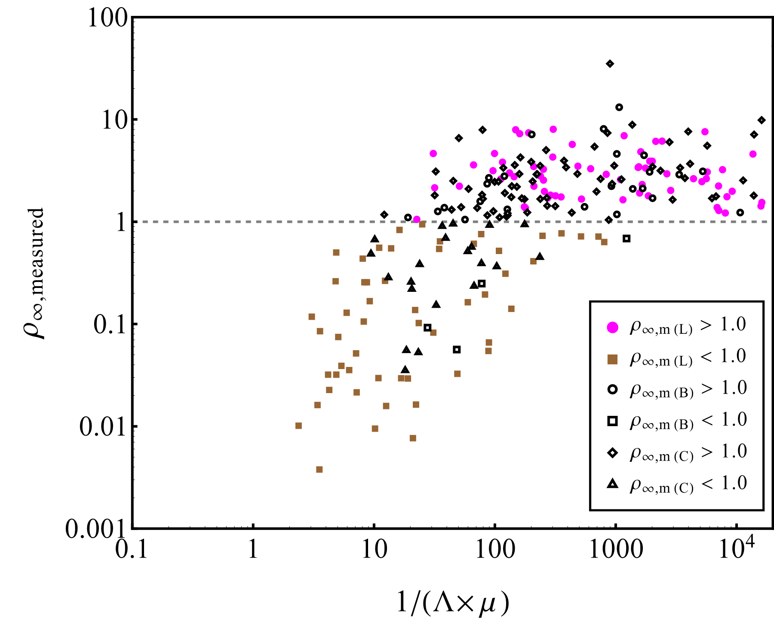
Treatment Sensitivity
Examining individual drug-disease combinations
Strength of immunotherapy response: the product of our super-parameters (Λ×μ)
Λ: anti-tumor immune state
μ: tumor kill rate
*m=measured
Increasing treatment efficacy

Slide 23
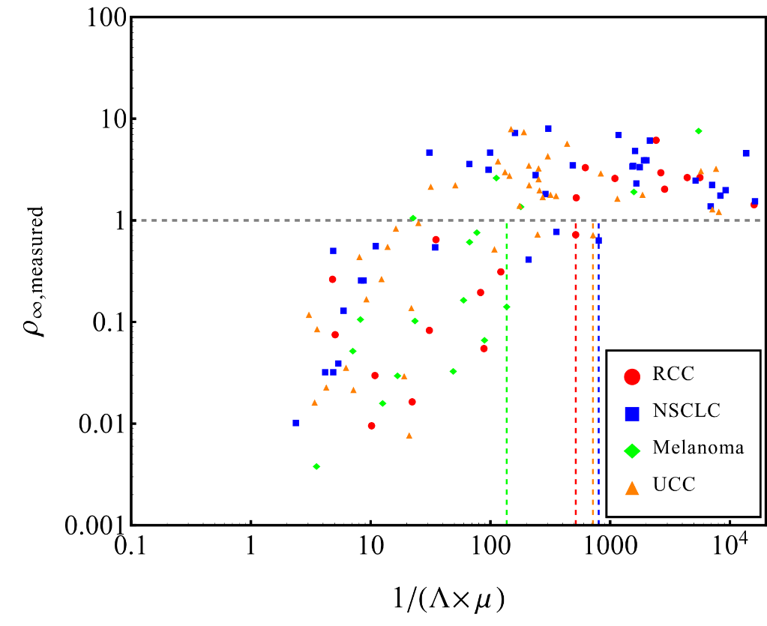
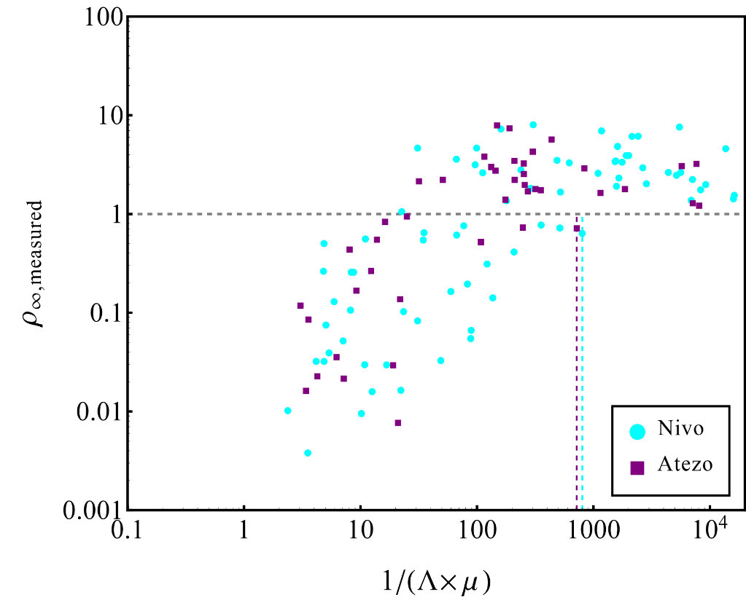
Treatment Sensitivity
Examining individual drug-disease combinations
 | $$ρ_{measured}^{∞}$$
Cancer type | k | R²
RCC | 0.00004 | 0.137486
NSCLC | 0.00031 | 0.165020
Melanoma | 0.00140 | 0.873101
UCC | 0.00039 | 0.106262
Clinical trial | 0.00048 | 0.177689
Basket-study | 0.00054 | 0.126117
Drug type | k | R²
Nivolumab | 0.00006 | 0.064571
Atezolizumab | 0.00039 | 0.106262
Clinical trial | 0.00048 | 0.177689
Basket-study | 0.00054 | 0.126117
We can quantify drug-disease sensitivity with the linear relationship y=kx
y: final tumor burden
k: (Λ×μ)⁻¹
Cancer type | Drug
RCC | Nivo
NSCLC | Nivo
Melanoma | Nivo
UCC | Atezo

Slide 24
Ongoing Work
New prognostic methods and possible model-guided clinical interventions
All model parameters may either be measured
Tumor volume (ρ), tumor growth rate (α)
Or changed by clinical intervention
Tumor kill rate (μ)
Drug dose
Drug dosing schedule
Combination therapy
Immune state (Λ)
Radiotherapy-induced increase in PD-1 expression
Abscopal effect: radiotherapy-induced release of antigens that prime the immune cells to attack other tumor cells, even in distant locations
Ongoing work
Model parameters may be informed by other standard-of-care measurements
Blood counts
Imaging measures of intratumoral anti-tumor immune state

Slide 25
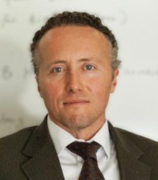
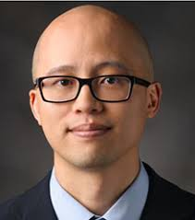
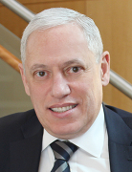
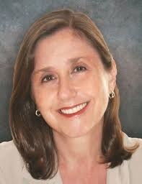
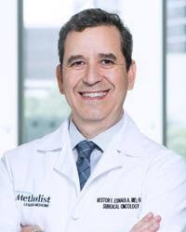
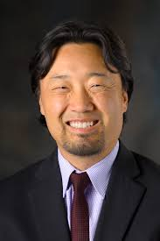
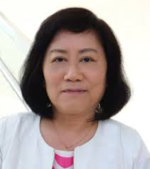
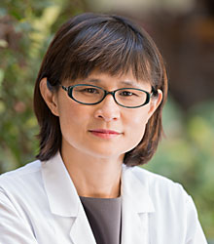
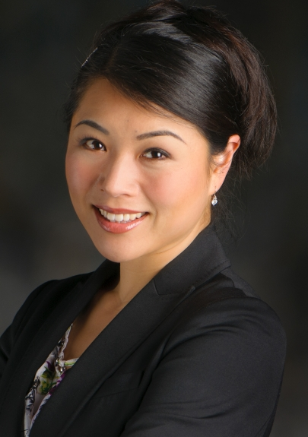
Special Thanks to…
This project was supported by:
National Science Foundation Grant DMS-1716737 (V.C., Z.W.)
National Institutes of Health (NIH) Grants 1U01CA196403 (V.C., Z.W.), 1U01CA213759 (V.C., Z.W.), 1R01CA226537 (V.C., Z.W.), 1R01CA222007 (B.O., G.A.C., V.C., Z.W.), U54CA210181 (V.C., Z.W.)
the Rochelle and Max Levit Chair in the Neurosciences (V.C.)
Vittorio Cristini, PhD
Houston Methodist Research Institute
Eugene J. Koay, MD, PhD
MD Anderson Cancer Center
Wadih Arap, MD, PhD
Rutgers Cancer Institute of New Jersey
Zhihui (Bill) Wang, PhD
Houston Methodist Research Institute
James W. Welsh, MD
MD Anderson Cancer Center
Renata Pasqualini, PhD
Rutgers Cancer Institute of New Jersey
Nestor F. Esnaola, MD
Houston Methodist Cancer Center
David S. Hong, MD
MD Anderson Cancer Center
Charles X. Wang, PhD
Drexel University College of Medicine
Shu-Hsia Chen, PhD
Houston Methodist Research Institute
Dalia Elganainy, MD
Dana-Farber Cancer Institute
Other contributors:
Geoffrey V. Martin, MD
George A. Calin, PhD
Prashant Dogra, PhD
Karine A. Al Feghali, MD
Javier Ruiz Ramirez, PhD
Sara Nizzero, PhD
Maria J. Pelaez
Jenny C. Chang, MD
Houston Methodist Cancer Center
Caroline Chung, MD
MD Anderson Cancer Center

